Slide 1

Programación concurrente y distribuida
Leonardo Camargo Forero, M.Sc
Sesión V

Slide 2
Contacto
Leonardo Camargo Forero, M.Sc
Asistente de investigación – Computación Científica Centro de Bioinformática y Biología Computacional. Ecoparque los Yarumos - Ed. BIOS
leonardo.camargo@bios.co

Slide 3
Agenda
Distributed systems
Communications
Interactions
Synchronization
Sockets
Threads
Questions

Slide 4

Distributed systems
http://www.colocationamerica.com/picts/articles/Worldwide-Network.jpg

Slide 5
Communication
Main feature of any distributed system.

Slide 6
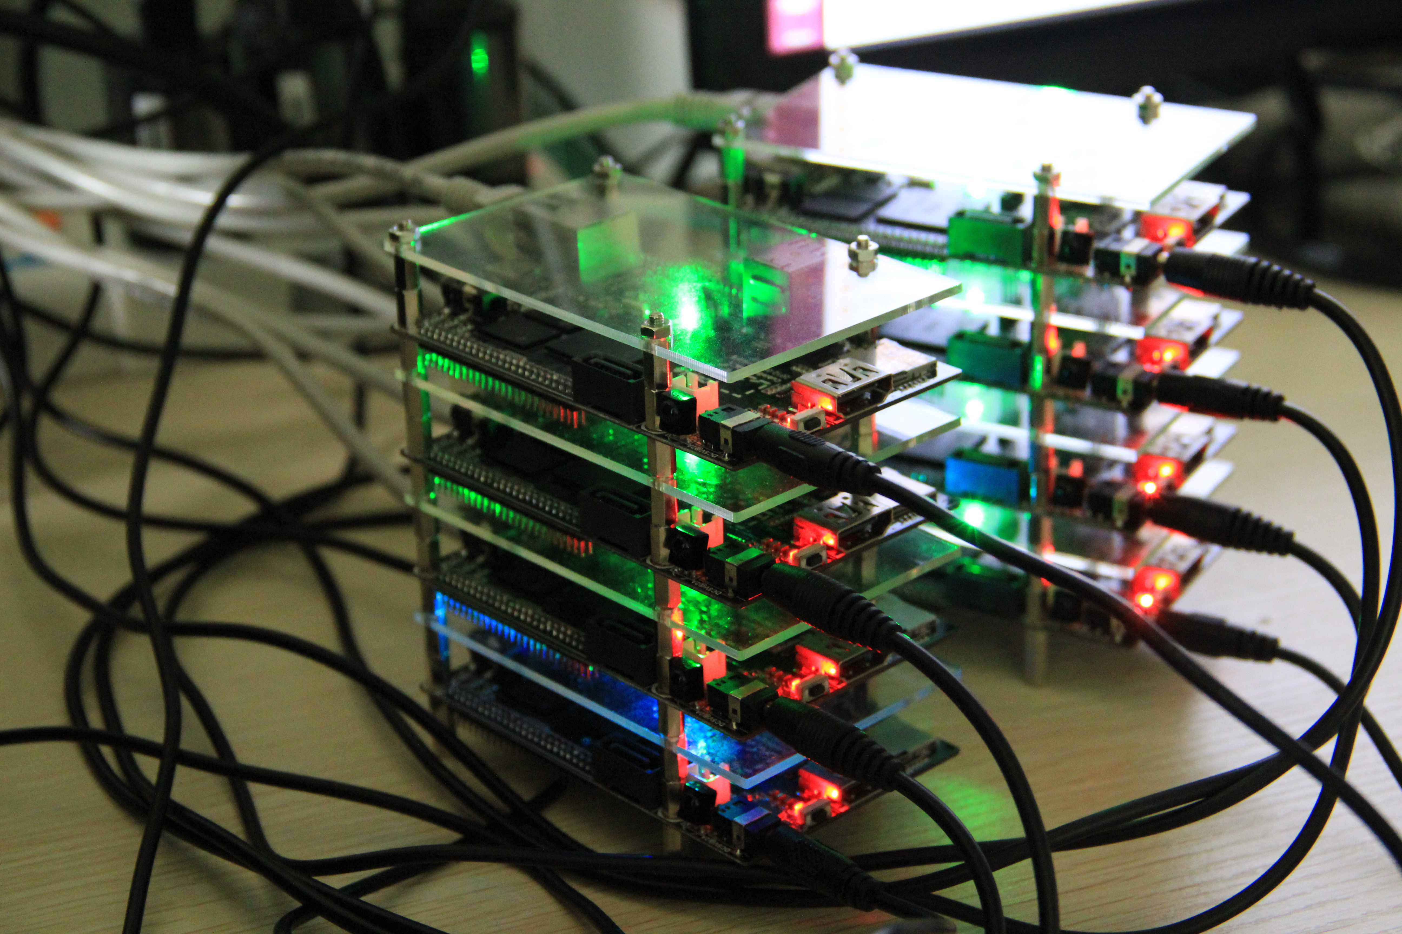
Communications
http://www.colocationamerica.com/picts/articles/Worldwide-Network.jpg
http://upload.wikimedia.org/wikipedia/commons/2/27/Cubieboard_HADOOP_cluster.JPG

Slide 7
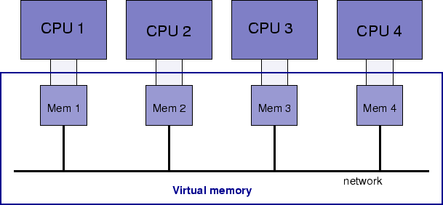
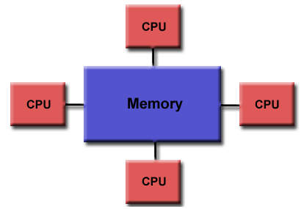
Types of communication
According to the memory:
Distributed shared memory: Shared memory:
http://www.oser.org/~hp/ds/img12.gif
https://computing.llnl.gov/tutorials/parallel_comp/images/shared_mem.gif

Slide 8
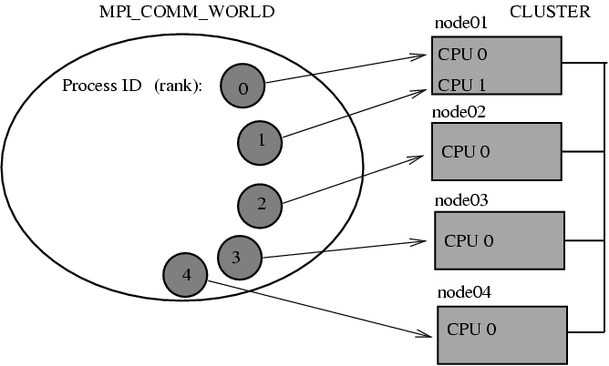
Types of communication
According to the memory:
An alternative …… Message Passing
http://linuxcourse.rutgers.edu/lessons/HPC_1/mpi_comm_world.gif

Slide 9
Types of communication
Message passsing
Features
Primitive: Sending and reception basic operations
Asynchronous operation mode (Non blocking sending, blocking reception)
Connectionless or connection based
Complex programming model

Slide 10
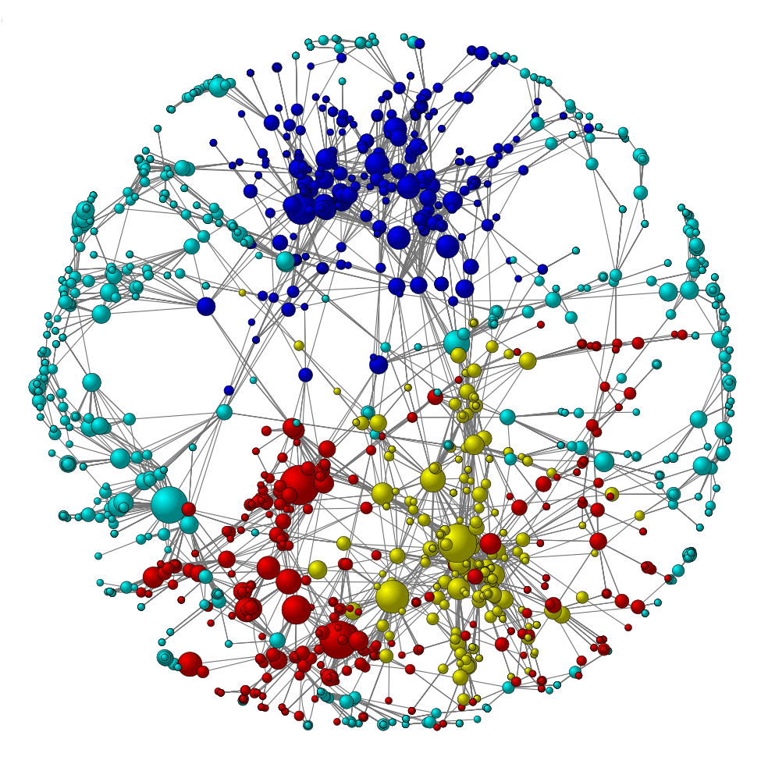
Interactions
http://www.colocationamerica.com/picts/articles/Worldwide-Network.jpg
http://www.annmccranie.net/site/images/network2.gif

Slide 11
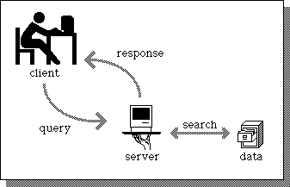
Types of interaction
Server Client model:
Most common scheme
Efficiency ??
http://infomotions.com/musings/waves/media/client-server-illustration.gif

Slide 12
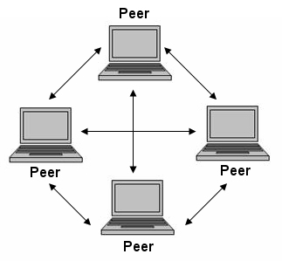
Types of interaction
Peer-to-Peer model:
Overlay network
Security??
http://evrak.files.wordpress.com/2011/11/p2p.jpg

Slide 13
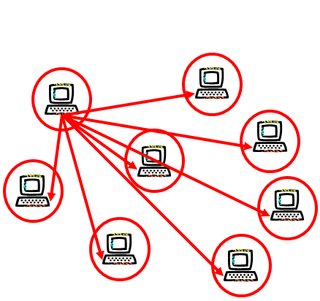
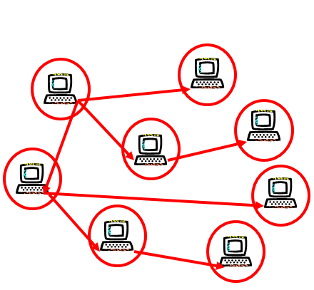
Types of interaction
Comparison
Server Client model P2p model
Taken from Arnaud Legout’s course: From BitTorrent to Privacy. Ubinet Master. Université Nice Sophia Antipolis. 2011 – 2012

Slide 14
Types of interaction
Comparison

Slide 15
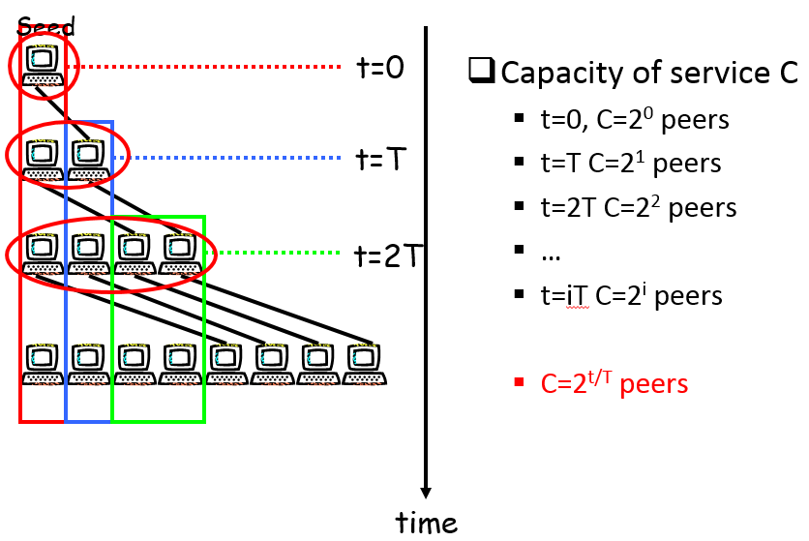
Types of interaction
P2P Service capacity explanation
Taken from Arnaud Legout’s course: From BitTorrent to Privacy. Ubinet Master. Université Nice Sophia Antipolis. 2011 – 2012

Slide 16
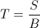
Types of interaction
P2P Service capacity explanation
S = Content size
B = Upload capacity
N -1 peers want the content
Iteration | Time (t) | Service capacity (C) | Service capacity (C) (Binary form)
0 | 0 | 1 | 2⁰
1 | T | 2 | 2¹
2 | 2T | 4 | 2²
3 | 3T | 8 | 2³
4 | 4T | 16 | 2⁴
I | iT | 2^{i} | 2^{i}
Para t=iT C= 2^{i} entonces C = 2 ^{t/T}

Slide 17

Synchronization
http://www.colocationamerica.com/picts/articles/Worldwide-Network.jpg

Slide 18
Synchronization
Emisor
Receiver
8
5
Emisor core
7
ACK
6
Receiver core
1
Communication pipe
4
Message
2
3
Asynchronous [1,8]: Emisor continues after passing messagle to core
Synchronous transmission [1,2,7,8]: Emisor waits message transmission over the network
Synchronous reception [1,2,3,6,7,8]: Emisor waits receiver core receives message
Synchronous delivery [1,2,3,4,5,6,7,8]: Emisor waits receiver process receives message
Synchronous response [1,2,3,4,Service, 5,6,7,8]: Emisor waits receiver process to process message
Taken from Gustavo Isaza’s course: Distributed and concurrent programming. University of Caldas.

Slide 19
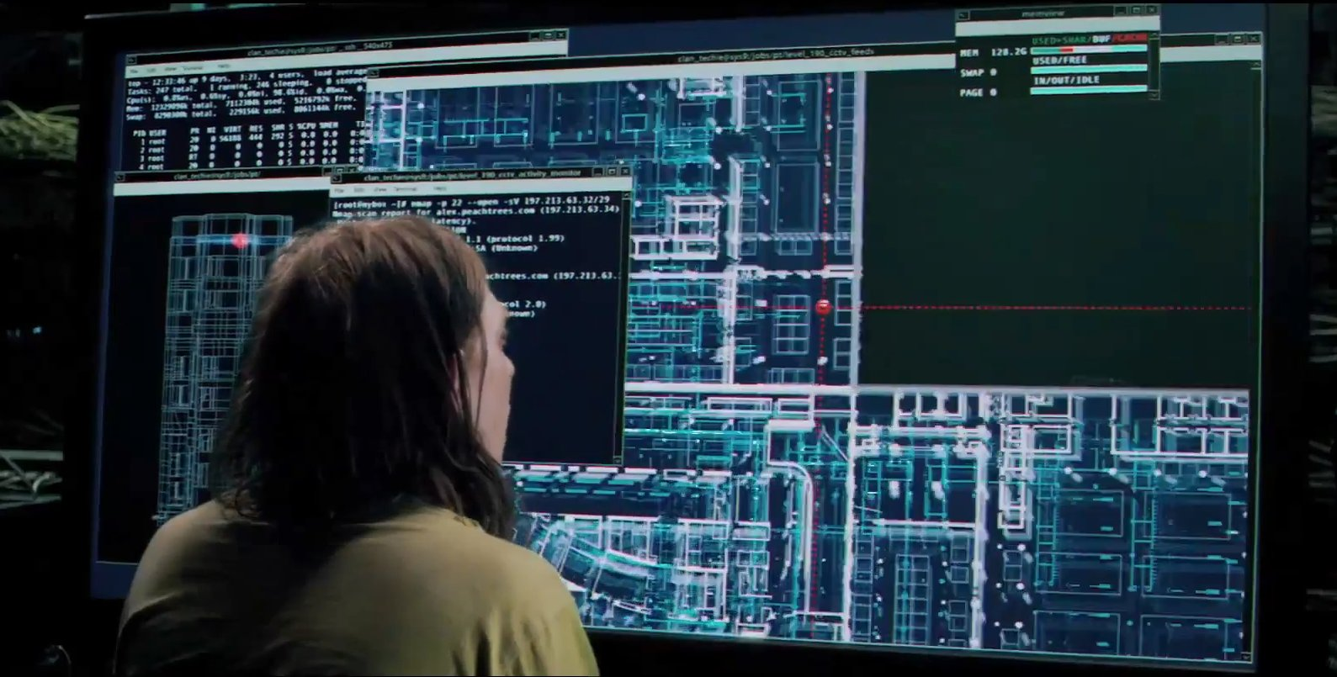
Sockets
http://www.colocationamerica.com/picts/articles/Worldwide-Network.jpg

Slide 20
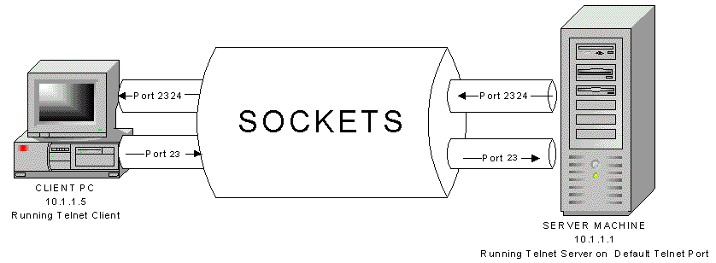
Sockets
Features
Communication endpoint
Associated to the transport layer
Composed of an IP and a port
Bidirectional communication (pipe)
Find out about SSL and TLS
http://www.ortizonline.com/images/sockets.gif

Slide 21
Sockets
Communication domain
Domain is a family of protocols.
Sockets are associated to a domain after creation
Only sockets belonging a same domain can communicate
Examples:
PF_UNIX (PF_LOCAL): Inside a machine
PF_INET: Communication under TCP/IP

Slide 22
Sockets
Types
Stream (SOCK_STREAM):
Connection oriented
Reliable
Message delivery order is maintained
TCP (PF_INET)
Datagram (SOCK_DGRAM):
Connectionless oriented
Unreliable
Message delivery order is not guaranteed
UDP (PF_INET)

Slide 23
Sockets
Some extra information
Some known ports
Port | TCP | UDP | Service
20 | X | X | FTP
22 | X | X | SSH
23 | X | X | Telnet
80 | X |  | HTTP

Slide 24
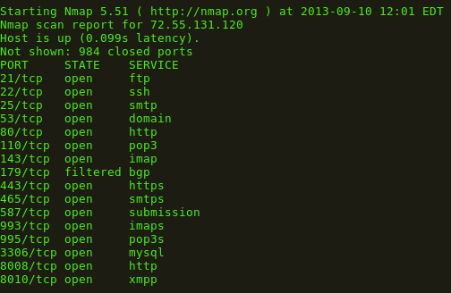
An example

Slide 25

Threads
http://www.colocationamerica.com/picts/articles/Worldwide-Network.jpg
http://nextwallpaper.com/thumbnails/large_Funny_Mouse_Computer_Sewing_Threads_35887.jpg

Slide 26
Threads
A definition (Taken from Wikipedia)
A thread of execution is the smallest sequence of programmed instructions that can be managed independently by an operating system scheduler. A thread is a light-weight process. The implementation of threads and processes differs from one operating system to another, but in most cases, a thread is contained inside a process. Multiple threads can exist within the same process and share resources such as memory, while different processes do not share these resources.

Slide 27
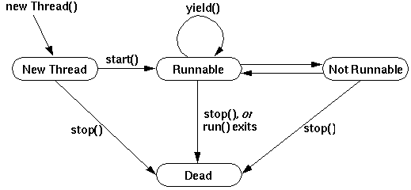
Threads
States

Slide 28
Threads
States
New: Creation momento
Runnable: Start method is executed
Not runnable: Thread is blocked (sleep(), wait () , trying to lock something, blocking on IO block thread). Notify method makes thread runnable
Dead: Run terminates normally or uncaught exception terminates run method. Dead thread cannot be restarted
Taken from Gustavo Isaza’s course: Distributed and concurrent programming. University of Caldas.

Slide 29
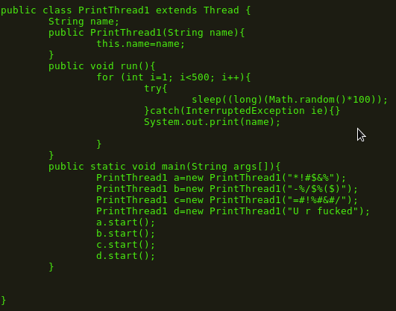
Threads
Example

Slide 30


